Slide 1
Introduction to Deep Learning
Module 1, Class 1

Slide 2
Agenda
Introduction to Functions or Maps
Learning as solution to an optimization problem
Why Neural Networks?
History of Neural Network
Agenda walk-through

Slide 3
Pre-read material
Deep Learning Book (Goodfellow, Bengio, Courville) — Chapter 1: Introduction Available free online: Deep Learning Book → Gives a history and motivation for deep learning in a non-technical way.
3Blue1Brown Video Series: “But what is a Neural Network?” (YouTube) 3Blue1Brown Neural Networks Playlist → Visual and intuitive introduction to neural networks as function mappers.

Slide 4
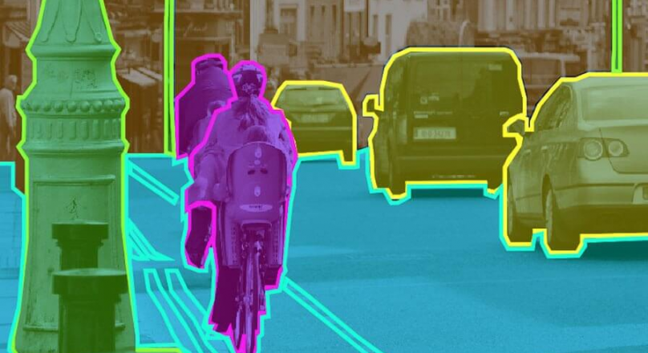
Many practical problems can be represented as a Map
Context
LLM
Next word
Image Segmentation
Segmentation mask
Image
Sentiment Analysis
Sentiment probabilities
Text
Customer data
Speech Sample
Transcription
Transcribed Text
Recommendation System
Offer Ranking
Offers
Notes:
Input/Output spaces is quite different
Text: sequence of words
Images: 2D

Slide 5
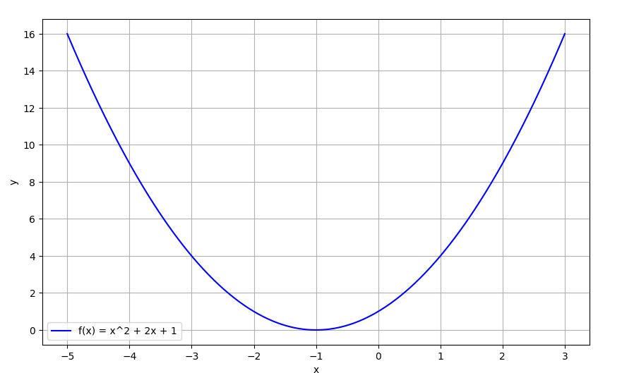
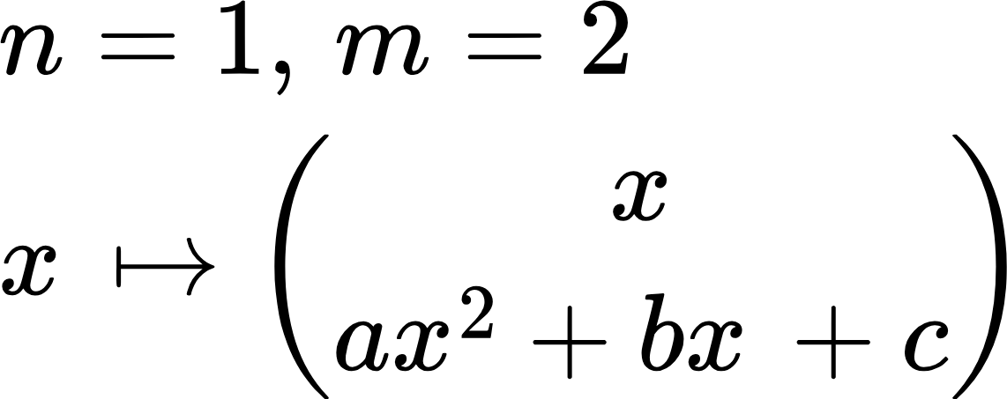
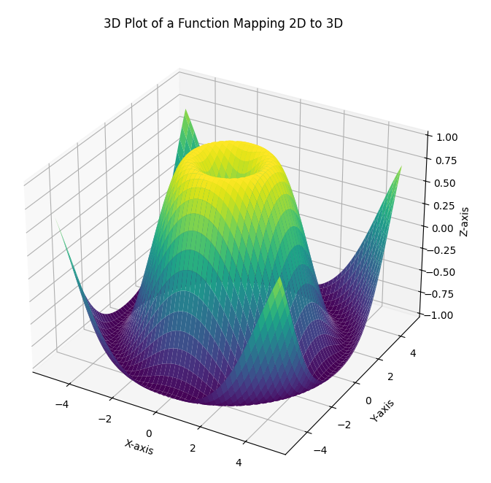
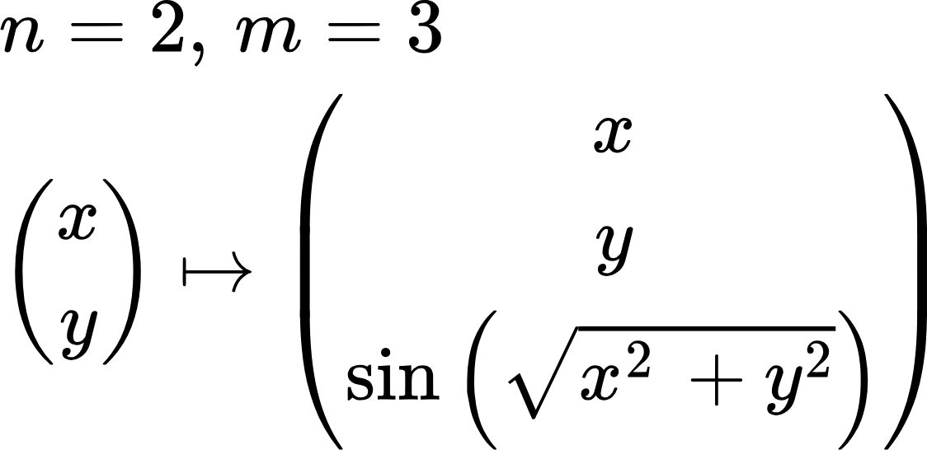
Maps are Functions in Math speak
In math, functions map a point in Rn to Rm.
What is a dimension? Number of things that can vary independently. Points along a line are 1D, on a plane: 2D, in space: 3D..
Mapping points along a line to a curve.

Slide 6
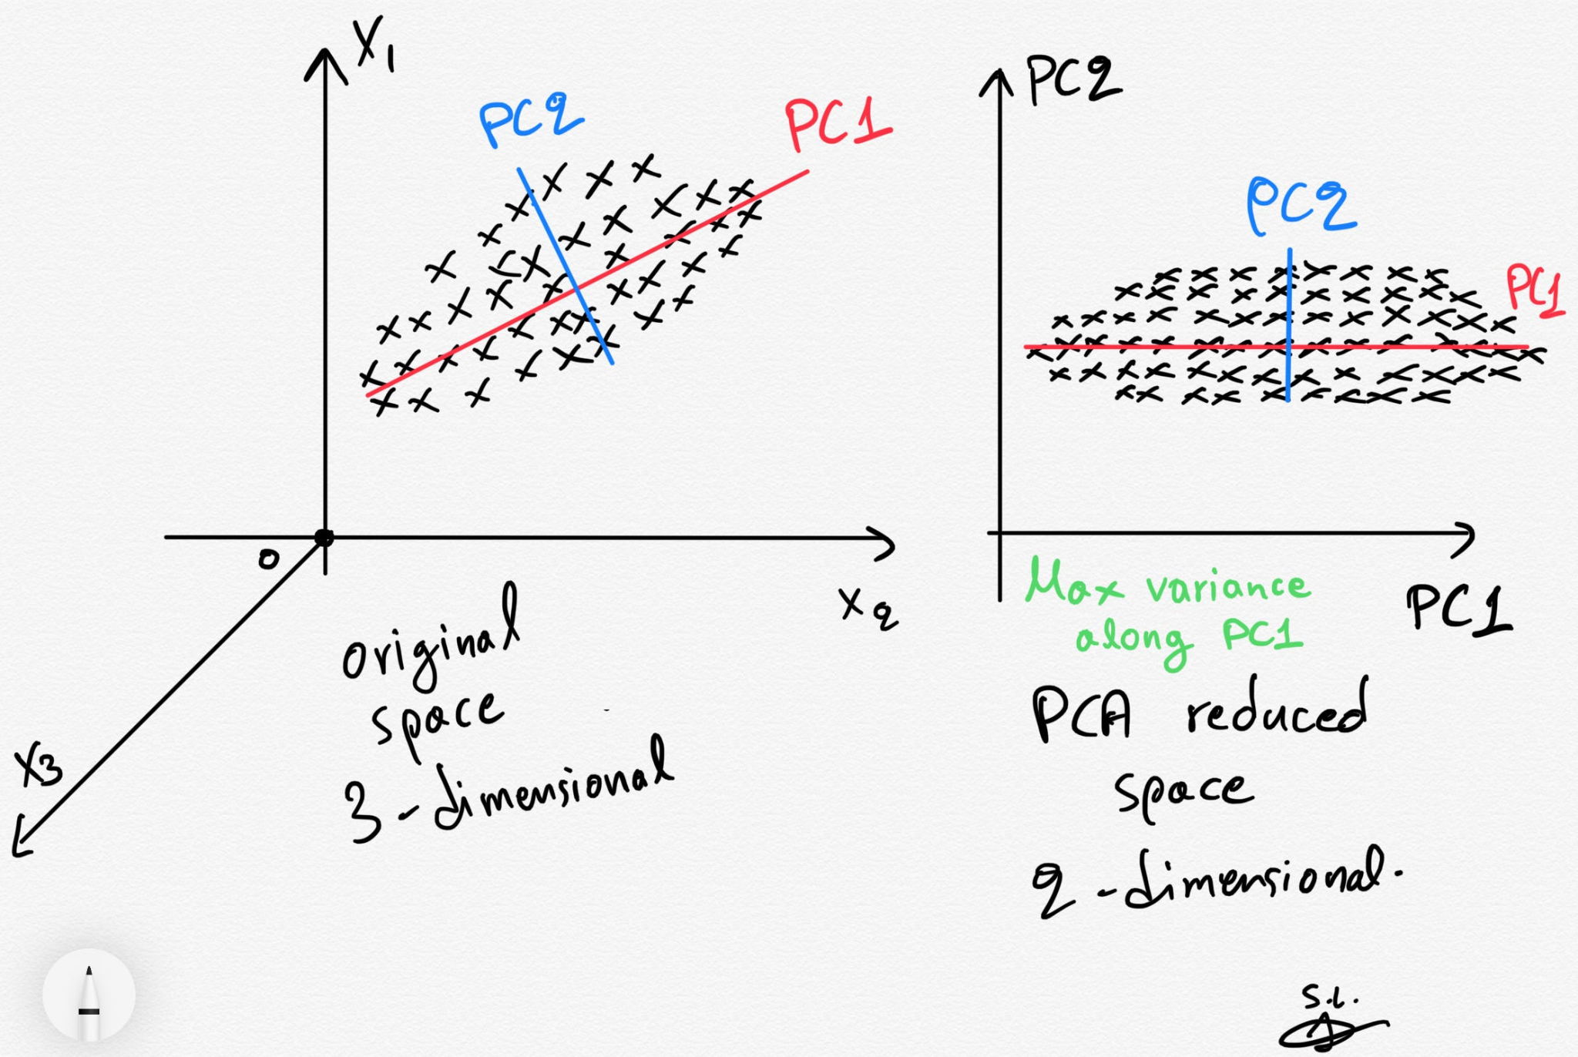
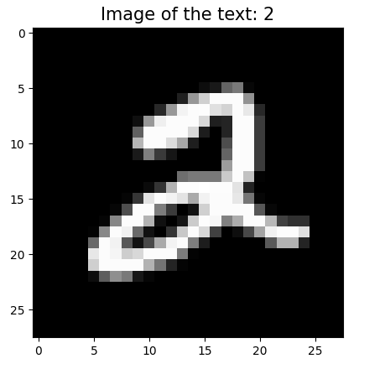
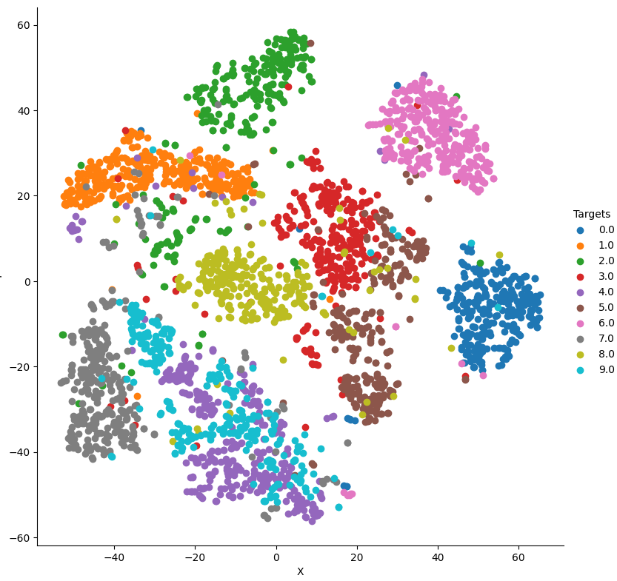
Functions = Maps
Some other examples..
PCA: Dimensionality reduction technique to preserve variation
t-SNE: Visualization technique to visualize vectors in high-dimensional spaces that preserves structure
Reshape to 784 * 1
t-SNE
Digit 2 from the MNIST dataset (28, 28, 256)
Code: mnist_t-sne.py

Slide 7

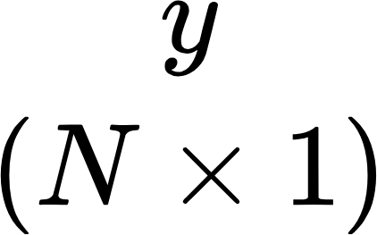
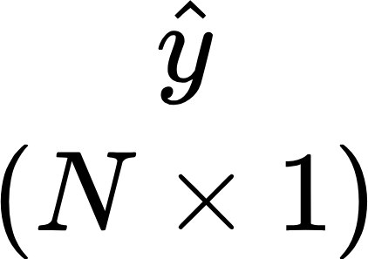
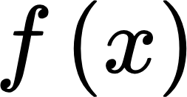
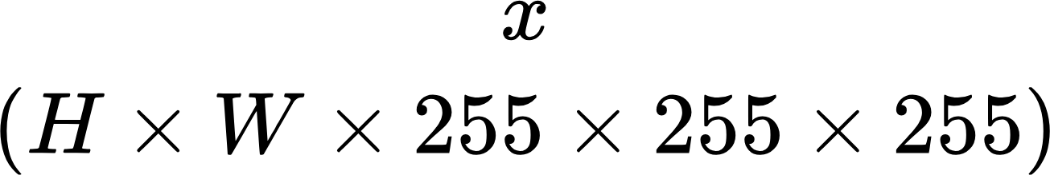
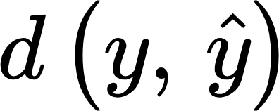
Functions = Maps
Case 1: Image Classification
Probabilities
Labels
1
0
0
0
Cat
0.6
0.05
0.06
0.01
Dog
Mapping
Number of classes
Chicken
Diff

Slide 8



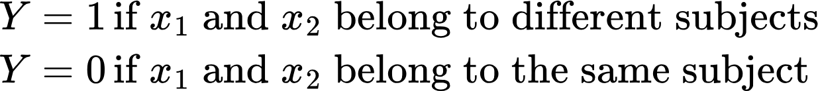

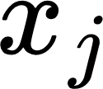
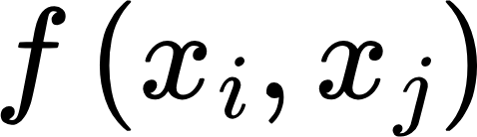

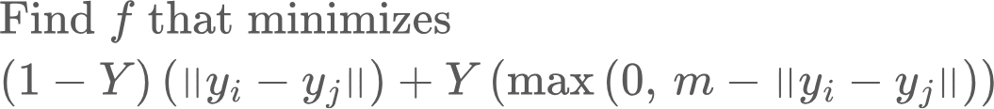
Functions = Maps
Case 2: Face Recognition
Subject 1
Mapping
Subject 2
When yi and yj belong to the same subject, we want to drive them as close as possible
When yi and yj belong to different subjects, we want to drive them as far as the margin m, but no farther.. To keep the task simple. m can then be used as the decision threshold

Slide 9
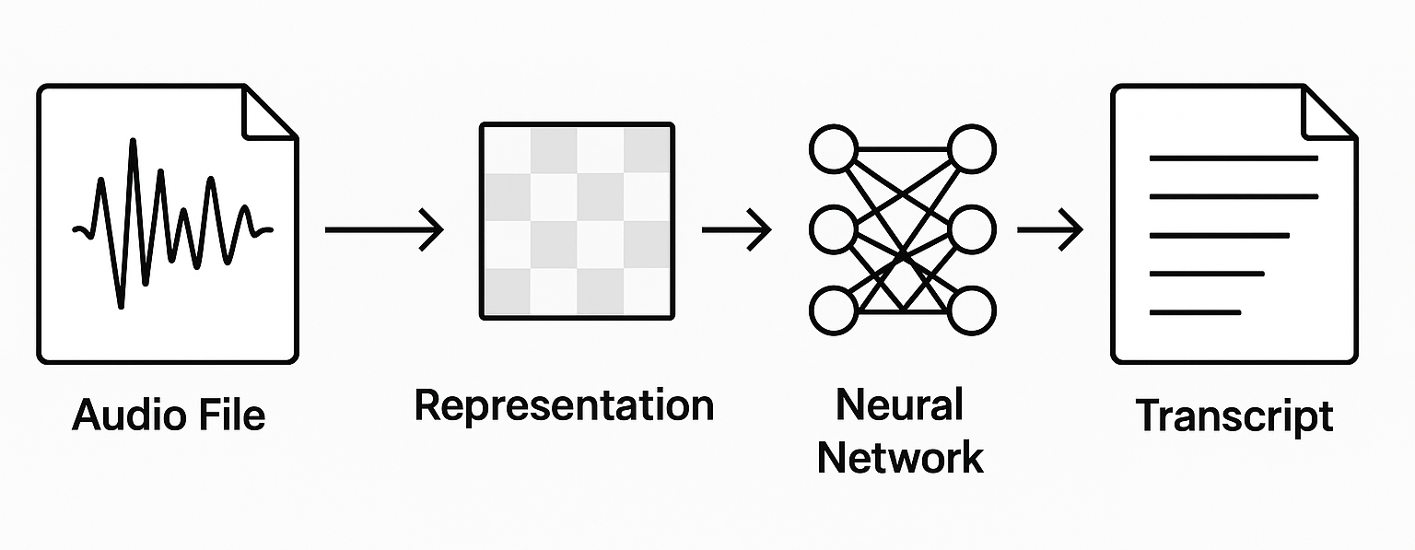
Feature Extraction
Before raw input is fed into a mapper, it must be transformed into a representation that is often more compact and captures essential information from the raw input, but is generally not invertible. These representations are sometimes called features. They can themselves be learnt.
Examples: Fourier/wavelet transform in speech, embeddings in text, mean/variance/max/min in numerical data
Audio Transcription

Slide 10
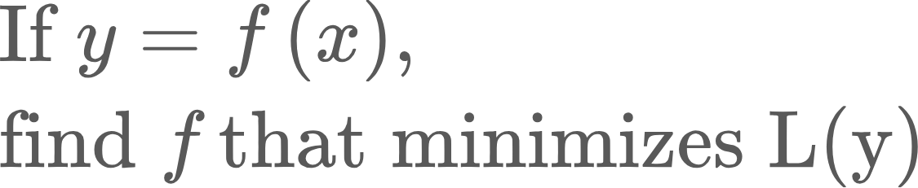
So we have an optimization problem!
Here, L(y) is called a Loss function. It measures the difference between output of the function f and some groundtruth (classification label, audio transcription)..
But.. f is some function in a high-dimensional space.. We don’t know its form--linear, quadratic.. number of parameters etc. All we have is input and desired output.
Can we learn an unknown function in a high dimensional space using relatively simple and scalable math?

Slide 11
Yes we can!
And that’s where neural networks come in!
Key ideas:
Map to higher dimensions: Complex relationships in lower dimensions can become tractable in higher dimensions
Concatenating linear functions with simple non-linear functions (eg, piecewise linear functions) can approximate any non-linear function
Learn from examples, rather than formulate rigid rules. What makes a cat a cat?

Slide 12
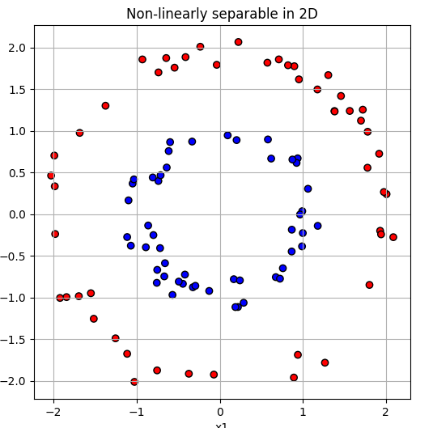
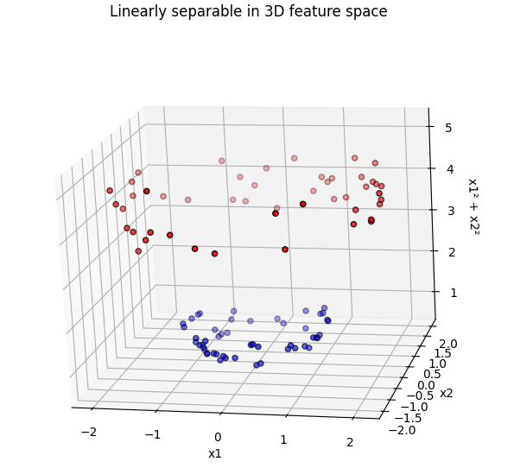
High dimensions can make things easier
Code: high_dim_separability.py

Slide 13
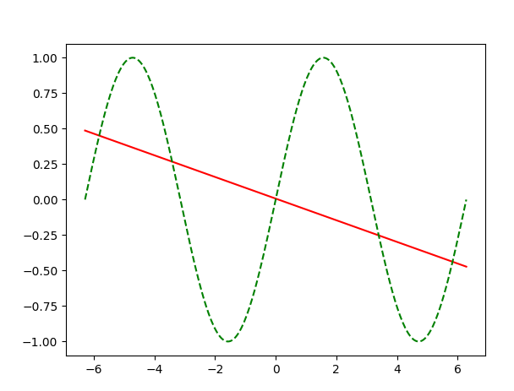
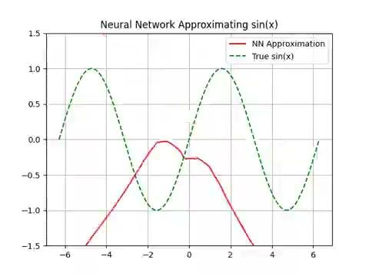
Concatenating linear functions and simple nonlinear functions can approximate any function!
We’ll soon learn how to build this!
The nonlinearity is key!
Without ReLU
With ReLU

Slide 14
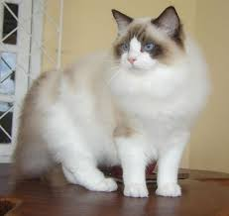


Can you describe a cat?
Anyone can tell a cat from a dog.. But can you define what makes a cat a cat?
Defining rules is brittle, because nature (and us) likes to break rules.
Learning from examples is better, and let the “brain” figure out the rules
So what makes a cat a cat? Who cares.. I know a cat when I see it :-)
This is a cat
So are these
And this..

Slide 15
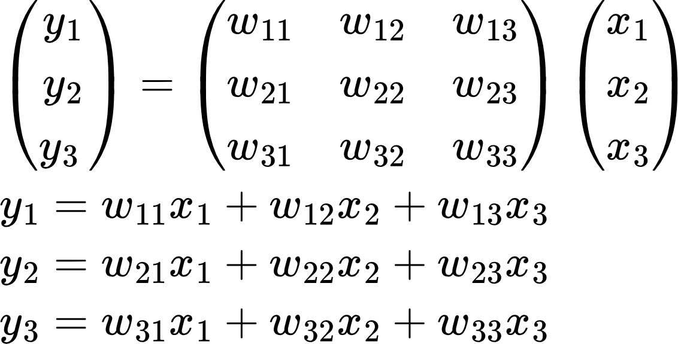
Some other desirable properties
Neural network calculations are simple and parallelizable. In face, most of the calculations in a neural network are matrix multiplications
Each of the products can be calculated in parallel
That’s why GPUs are so popular in Deep Learning!
They are massively parallel (designed to draw pixels on the screen, a parallel calculation)
Programmable using CUDA
Each of the y’s can be calculated in parallel

Slide 16
An interesting aside..
Is AI something new or an incremental advance?
Neural Networks, the workhorse of AI were invented in 1943.. But their true capabilities were never realized, because they remained “shallow” (1-2 layers)
Aha moment arrived in 2012. Alex Krizhevsky, Ilya Sutskever, and Geoffrey Hinton from U of Toronto won the ImageNet Large Scale Visual Recognition Challenge (ILSVRC) in 2012 using a 8 layered Neural Network, that significantly outperformed the competition
Rediscovery of Backpropagation
Dropout to prevent overfitting..
Algorithmic Advances
AI Revolution
Large Datasets
Large, high-quality labeled datasets such as ImageNet
Programmable GPUs
Highly efficient GPU implementation of matmul, convolution etc
https://proceedings.neurips.cc/paper_files/paper/2012/file/c399862d3b9d6b76c8436e924a68c45b-Paper.pdf

Slide 17
Homework problems
Run the code for this lecture
If you aren’t familiar with Python, take a Python programming class
Go through:
Intro to functions
Intro to Algebra
Intro to calculus 1
Do the problems! Very important to get hands-on practice.

